Slide 1

Aluminium
Solid and Flexible Cables
“Products for the Next Decade”
Selman ÜNLÜ
Mech. Eng, Deputy GM

Slide 2
Content of Presentation
1- Analyzing the feasibility of Aluminium Cables
1.1- Reel Disadvantages of Aluminium Cables
1.2- Comparisons of Conductive Metals in various applications
2- Aluminium Cable Applications (_Underground_Aerial_Building_)
3- Aluminium Flexible Cables
3.1- Design Criteria&Tests of Aluminium Flexible Cables
3.2- Types&Application Areas of Aluminium Flexible Cables
3.3- Predictions on Aluminium Flexible Cables
4- Challenges of Aluminium Cables
4.1- Integrity of Fine Wires
4.2- Connection and Termination

Slide 3
Ads and DisAds of Aluminium Cables
Advantages of Aluminium Cables
Disadvantages of Aluminium Cables
Cost Saving,
Historically more stable prices,
Less sensitive to market fluctuations
Youngest and most abundant metal
Lightweight,
Easy installation,
Easy maintenance,
Problem free connection,
High Corrosion Resistance
Larger Radial Sizes, Lack of Space,
Coefficient of Thermal Expansion,
Higher Resistivity,
Mechanical Strength
Connection Problems,
Oxidation Layer or Corrosion on Surface
Bending / Creep Failures

Slide 4
The Reel Disadvantages of Aluminium Cables
Consumer; Doubts about Connection/Termination due to bad reputations in 1960s and 1970s.
Government; Not included in Regulation or Standards.
Company; easily reach higher turnovers with copper cables during progress payments. So they are reluctant to use Aluminium.
Cables keep a low percentage cost in many projects, but cars.
Copper is a very much experienced metal (8000 years) than Aluminium (120years)
The number of actors in Copper business is higher than Aluminium.

Slide 5
Content of Presentation
1- Analyzing the feasibility of Aluminium Cables
1.1- Reel Disadvantages of Aluminium Cables
1.2- Comparisons of Conductive Metals in various applications
2- Underground&Aerial&Building Applications
3- Aluminium Flexible Cables
3.1- Design Criteria&Tests of Aluminium Flexible Cables
3.2- Types&Application Areas of Aluminium Flexible Cables
3.3- Predictions on Aluminium Flexible Cables
4- Challenges of Aluminium Cables
4.1- Integrity of Fine Wires
4.2- Connection and Termination

Slide 6
Characteristics of Conductive Metals
Material | ρ (10⁻⁸Ω·m) at 20 °C | σ (10⁷S/m) at 20 °C
Silver | 1.59 | 6.30
Copper | 1.68 | 5.96
Annealed Copper | 1.72 | 5.80
Gold | 2.44 | 4.10
Aluminium | 2.82 | 3.50
Where ρ is the Resistivity; σ is the Conductivity.

Slide 7
Characteristics of Conductive Metals
Pure Metal or Conductor | Conductivity Percent IACS Volume Basis¹ | Specific Gravity | Conductivity Percent IACS Weight Basis²
Pure Metal
Aluminum | 64,90 | 2,70 | 213,70
Copper | 103,10 | 8,93 | 102,60
Gold | 84,10 | 19,32 | 38,70
Magnesium | 38,70 | 1,74 | 197,70
Silver | 108,40 | 10,49 | 91,90
Sodium | 41,00 | 0,97 | 376,20
Titanium | 4,10 | 4,51 | 8,10
Electrical Conductors
AA-1350 | 61,20 | 2,705 | 201.10
AA-8000 | 61,00 | 2,71 | 200.10
Copper | 100,00 | 8,89 | 100,00
¹ Conductivity on a volume basis compares conductivities of metals for the same cross-sectional area and length.
² Conductivity on a weight basis compares conductivities of metals for the same weight.
Referred to as 100% IACS or International Annealed Copper Standard.

Slide 8
Characteristics of Aluminium and Copper
Conditions | Copper | Aluminium
Equal Cross-Section | 1 | 1
*Weight | 1 | 0,33
*Resistance | 1 | 1,6
*Conductivity | 1 | 0,625
*Current Carrying Capacity | 1 | 0,8
Equal Conductivity | 1 | 1
*Cross-Section | 1 | 1,6
*Diameter | 1 | 1,3
*Weight | 1 | 0,49
Equal Thermal Expansion | 1 | 1
*Cross-Section | 1 | 1,4
*Diameter | 1 | 1,17
*Weight | 1 | 0,42

Slide 9
Characteristics of Aluminium and Copper
Aluminium Series Used as Electrical Conductor
- 1050, 1070,
- 1120,
- 1350, 1370,
- 5154,
- 6101, 6201,
- 8030, 8070, 8176

Slide 10
Characteristics of Aluminium and Copper
Property | Copper (Cu-ETP) | Aluminium (1350) | Units
Electrical conductivity (annealed) | 101 | 61 | %IACS
Electrical resistivity (annealed) | 1.72 | 2.83 | uΩcm
Thermal conductivity at 20°C | 397 | 230 | W/mK
Coefficient of thermal expansion | 17 x 10^{ˉ6} | 23 x 10^{ˉ6} | /°C
Tensile strength (annealed) | 200-250 | 50-60 | N/mm²
Tensile strength (half-hard) | 260-300 | 85-100 | N/mm²
Elastic modulus | 116-130 | 70 | N/mm²
Thermal Storage Capacity | 0.092 | 0.214 | Cal/gr.ºC
Fatigue Strength (annealed) | 62 | 35 | N/mm²
Fatigue Strength (half-hard) | 117 | 50 | N/mm²
Specific heat | 385 | 900 | J/kgK
Density | 8.91 | 2.70 | g/cm³
Melting Point | 1083 | 660 | °C

Slide 11
Comparison of Aluminium and Copper in Cable
Electrical Equivalence
“Transferring Power form one source to consumer” described as
Equal Distance | Equal Resistance | Equal Voltage Drop
L_{Al} = L_{Cu} | R_{Al} = R_{Cu} | DU_{Al} = DU_{Cu}

Slide 12
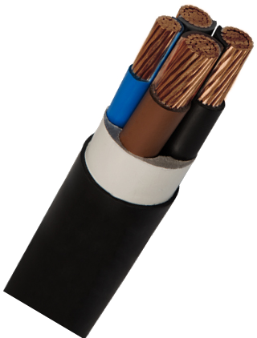
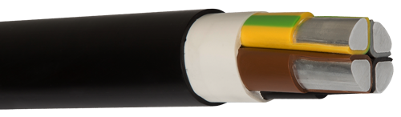
Comparison of Aluminium and Copper in Cable
What if…
Type | Cross-Section | Price (USD/km) | Diameter (mm) | Weight (kg/km)
NYY RM | 4x95 | 19,53 | 42,5 | 4975
NAYY SE | 4x120 | 4,18 | 41 | 2500
NA2X2Y SE | 4x120 | 4,15 | 41 | 2260
NAYY SE | 4x150 | 5,13 | 45 | 2770
NAY2Y SE | 4x150 | 5,08 | 45 | 2550
NA2X2Y SE | 4x150 | 5,15 | 45 | 2450
LME_{Cu} | 4.750 USD/ton
LME_{Al} | 1.650 usd/ton

Slide 13
Comparison of Aluminium and Copper in Cable
Copper Cable |  |  | Equivalent Aluminium Cable |  |  | Cu/Al Ratio | % Price Match
Cable Type | Cross-Section | Price (USD/km) | Cable Type | Cross-Section | Price (USD/km)
NYY | 4X10 | 2357 | NAYY | 4X16 | 782 | 3,01 | 66,82
NYY | 3X16+10 | 2572 | NAYY | 3X25+16 | 1229 | 2,09 | 52,22
NYY | 3X25+16 | 5091 | NAYY | 3X35+16 | 1456 | 3,50 | 71,40
NYY | 3X35+16 | 6639 | NAYY | 3X50+25 | 2016 | 3,29 | 69,63
NYY | 3X50+25 | 9513 | NAYY | 3X70+35 | 2680 | 3,55 | 71,83
NYY | 3X70+35 | 13208 | NAYY | 3X120+70 | 4419 | 2,99 | 66,54
NYY | 3X95+50 | 17979 | NAYY | 3X150+70 | 5239 | 3,43 | 70,86
NYY | 3X120+70 | 22970 | NAYY | 3X185+95 | 6489 | 3,54 | 71,75
NYY | 3X150+70 | 27727 | NAYY | 3X240+120 | 8454 | 3,28 | 69,51
Cu_{LME} | 4.750 USD/ton
Al_{LME} | 1.650 usd/ton

Slide 14
Comparison of Aluminium and Copper in Cable
Copper Cable |  |  |  | Equivalent Aluminium Cable
Cable Type | Cross-Section | Cu Factor | Price (USD/km) | Cable Type | Cross-Section | Al Factor | Price (USD/km)
NYY | 4x10 | 356 | 2282 | NAYY | 4x16 | 173 | 796
NYY | 4x95 | 3382 | 19529 | NAYY | 4x150 | 1620 | 5967
NYY | 4x240 | 8544 | 49653 | NAYY | 4x400 | 4320 | 15200
NYM | 4x2,5 | 89 | 584 | NAYM | 4x4 | 43 | 505
NYM | 4x6 | 213,6 | 1317 | NAYM | 4x10 | 108 | 630
H07V-K | 1,5 | 13,35 | 76,15 | AH07V-K | 2,5 | 6,75 | 52
H07V-K | 70 | 623 | 3404 | AH07V-K | 120 | 324 | 1680
H07V-K | 150 | 1335 | 7363 | AH07V-K | 240 | 648 | 3420
H05VV-F | 4x0,75 | 26,7 | 216 | AH05VV-F | 4x1,5 | 16 | 175
H05VV-F | 4x2,5 | 89 | 586 | AH05VV-F | 4x4 | 43,2 | 425
Cu_{LME} | 4.750 USD/ton
Al_{LME} | 1.650 usd/ton

Slide 15
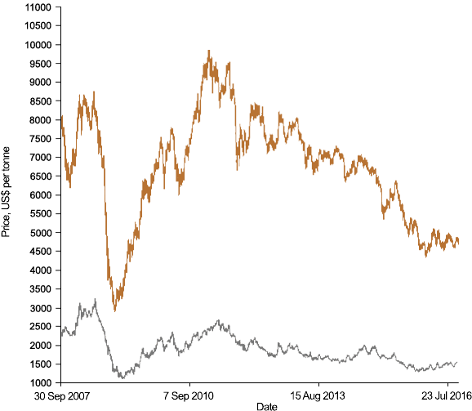
Comparison of Aluminium and Copper in Cable
LME CASH METAL PRICE GRAPH USD/tonne
Today
Al 1650
Cu 4750

Slide 16
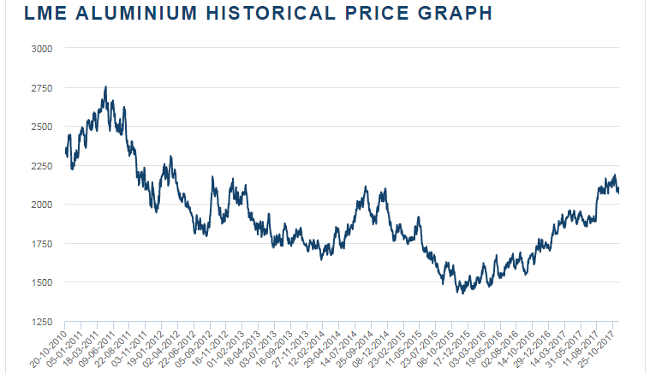
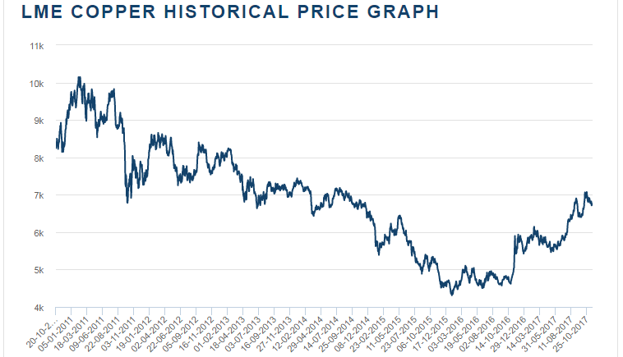
Comparison of Aluminium and Copper in Cable
LME CASH METAL PRICE GRAPH USD/tonne
LME_{Al} 2067 USD/Mton
LME_{Cu} 6750 USD/Mton

Slide 17
Content of Presentation
1- Analyzing the feasibility of Aluminium Cables
1.1- Reel Disadvantages of Aluminium Cables
1.2- Comparisons of Conductive Metals in various applications
2- Underground&Aerial&Building Applications
3- Aluminium Flexible Cables
3.1- Design Criteria&Tests of Aluminium Flexible Cables
3.2- Types&Application Areas of Aluminium Flexible Cables
3.3- Predictions on Aluminium Flexible Cables
4- Challenges of Aluminium Cables
4.1- Integrity of Fine Wires
4.2- Connection and Termination

Slide 18
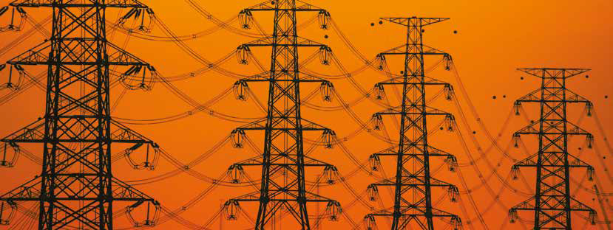
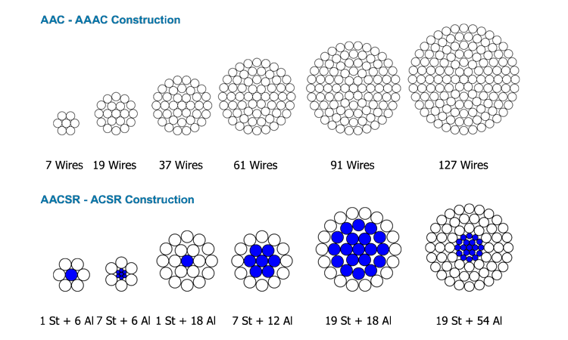
Overhead Conductors
AAC
ACSR
AAAC
AACSR

Slide 19
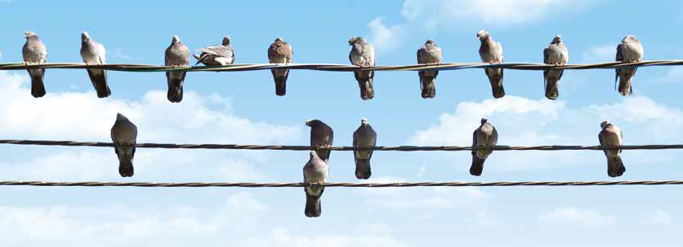
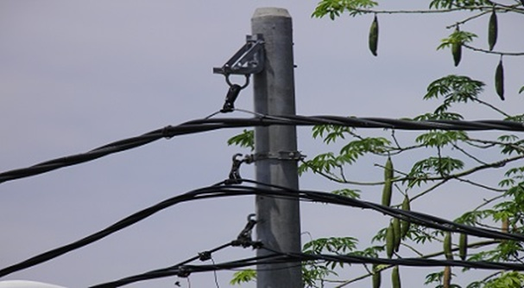
Aerial Bundled Cables
For temporary supplies,
In theft prone areas instead of bare conductors,
In hilly terrains,
In developing urban complex,
Danger risk of touching trees,
In rainy lands,

Slide 20
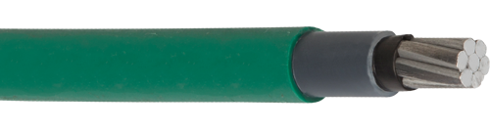
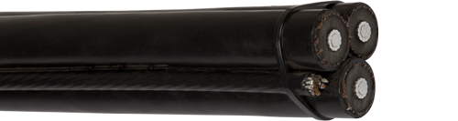
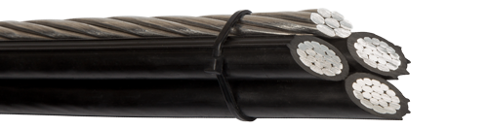
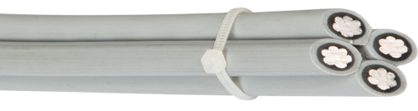
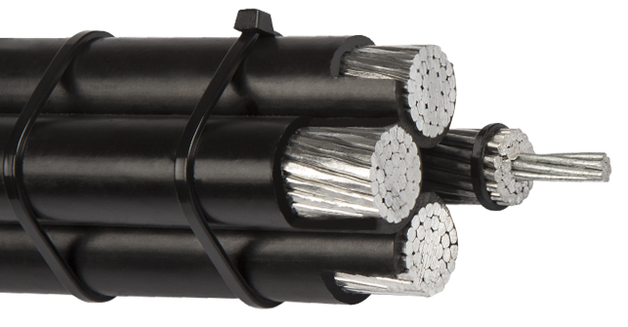
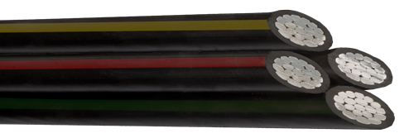
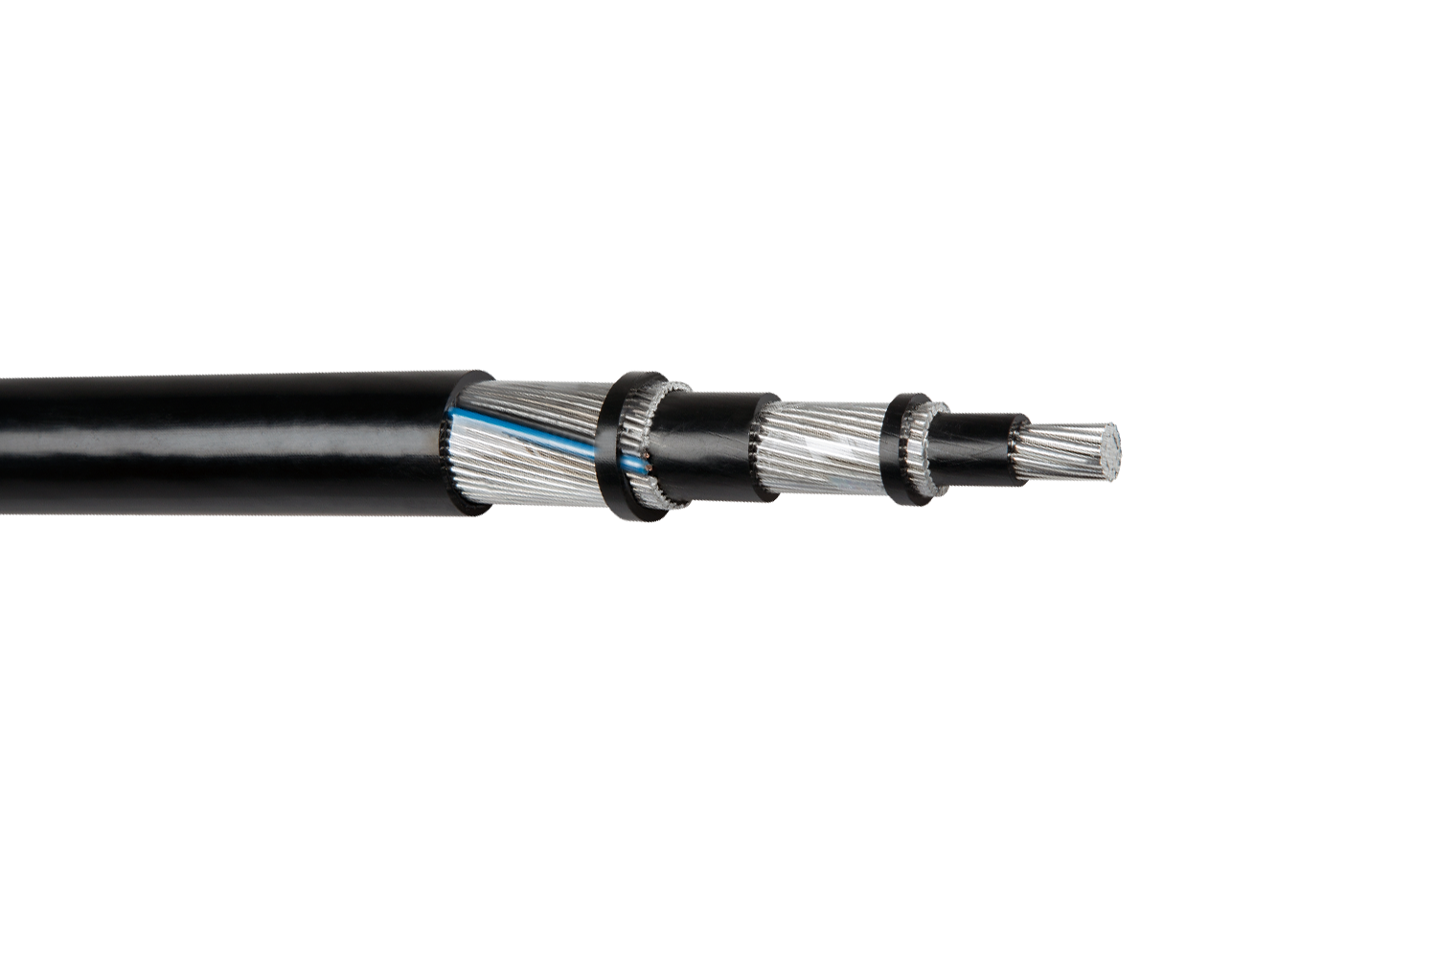
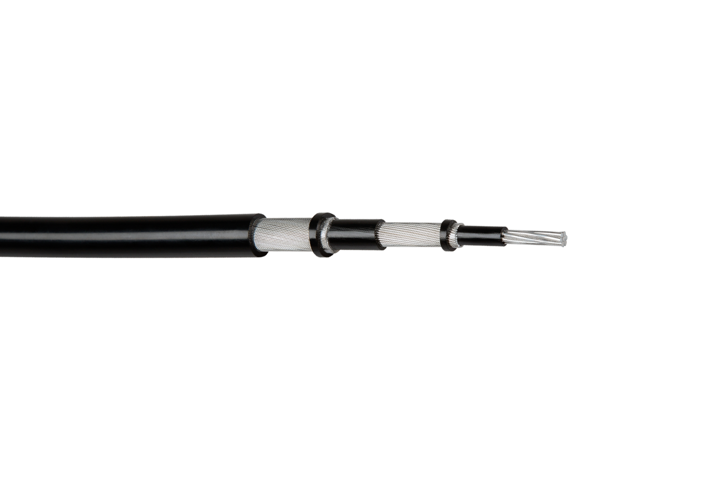
Types of LV&MV Aerial Bundled Cables

Slide 21
Types of LV&MV Aerial Bundled Cables

Slide 22
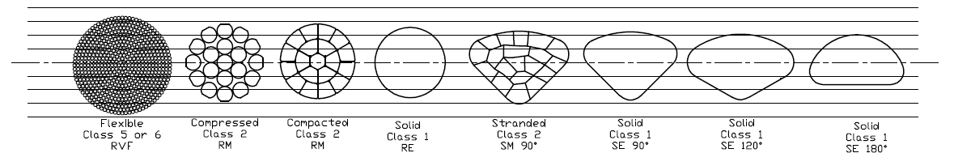
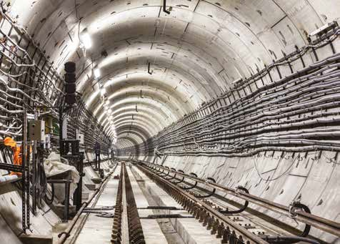
Underground Cables
- Conductor Types
- Insulation&Sheathing;
XLPE, PVC, HFFR, Rubber..
Armouring
SWA, STA, AWA, Cu, CW
- Many varieties can be applicable

Slide 23
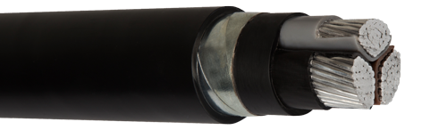
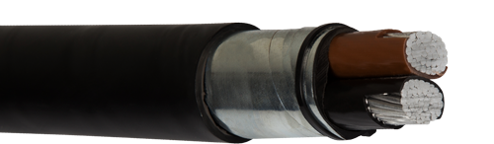
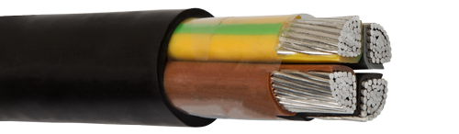
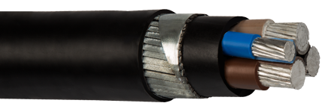
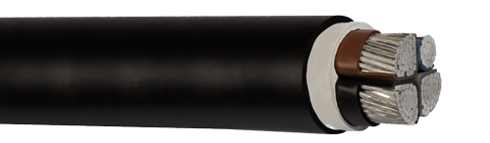
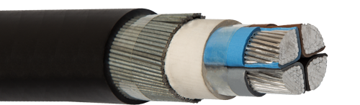
Types of Underground Cables

Slide 24
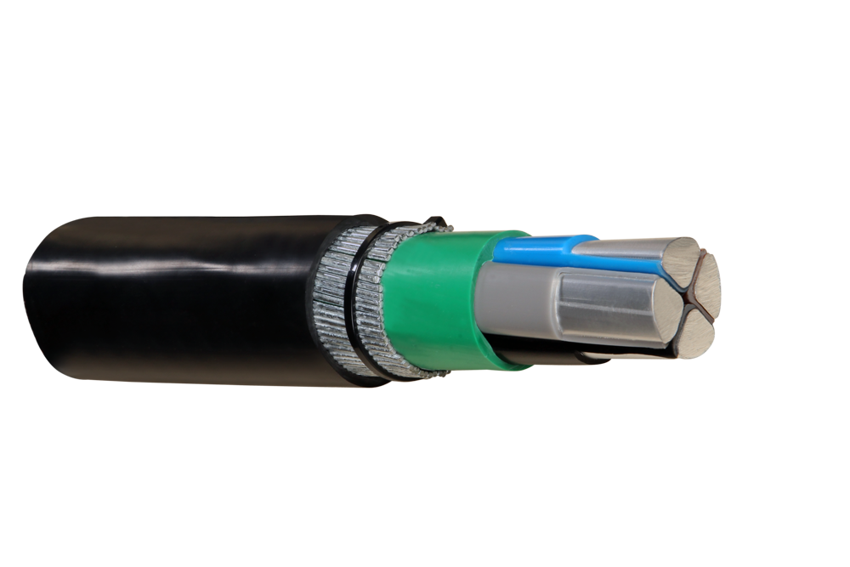
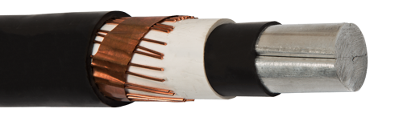
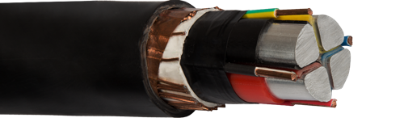
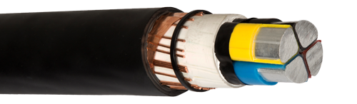
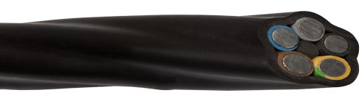
Types of Underground Cables

Slide 25
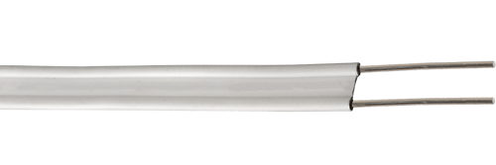
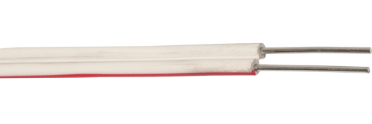
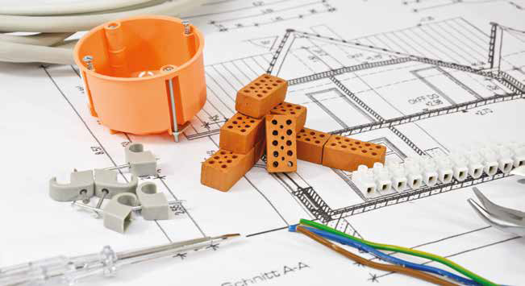
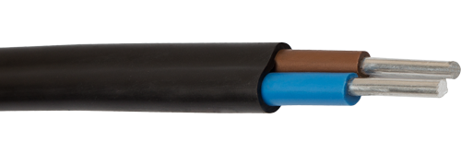
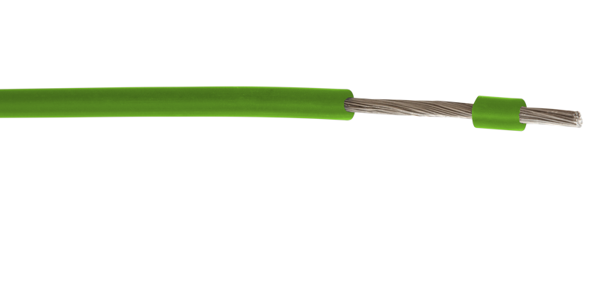
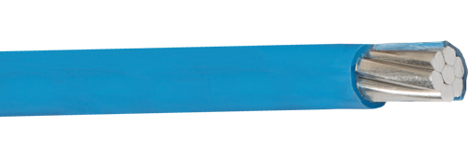
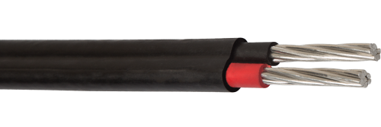
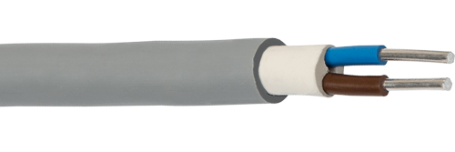
Aluminium Building Cables
“Today, Aluminum building wiring is safe and reliable”
Since 1970s, with the development of improved Conductors and connectors, changes have made installing aluminum building wire as simple as installing copper.

Slide 26
Aluminium Building Cables
During Connection, Please Consider
1. Interoperability of Accessories and Aluminium,
2. Workmanship Quality,
3. Physical Properties of Accessories,
4. Thermal Expansion Differences,
5. Creep and Voltage Drop Conditions,
6. A Thin protective Oxide layer on Aluminium is broken during termination,
7. Material Grade of Conductor,
8. Proper tightening (torquing) is essential to achieve a reliable connection,
9. All electrical connections should be periodically inspected,
10. A compatible Oxide Inhibitor is recommended,
11. Environmental Conditions,

Slide 27
Aluminium Building Cables
During Connection, Please Avoid from
1. Poor Workmanship,
2. Undesirable Accessories,
3. Imprudent Termination,
4. Improper Tightening Torque,
5. Rapid conductor deformation due to creep,
6. Excessive mechanical load and connector degradation,
7. Do not re-torque the terminations as part of routine maintenance, if not loose,
8. Over tightening can lead to damaged conductors and connection points

Slide 28
Content of Presentation
1- Analyzing the feasibility of Aluminium Cables
1.1- Reel Disadvantages of Aluminium Cables
1.2- Comparisons of Conductive Metals in various applications
2- Underground&Aerial&Building Applications
3- Aluminium Flexible Cables
3.1- Design Criteria&Tests of Aluminium Flexible Cables
3.2- Types&Application Areas of Aluminium Flexible Cables
3.3- Predictions on Aluminium Flexible Cables
4- Challenges of Aluminium Cables
4.1- Integrity of Fine Wires
4.2- Connection and Termination

Slide 29
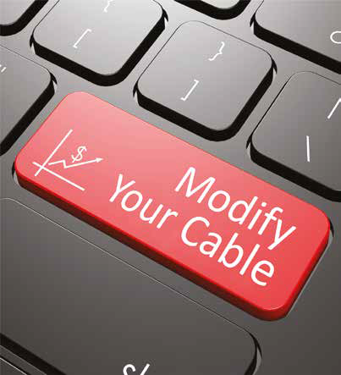
Aluminium Flexible Cables
“Product for the Next Decade”
Aluminium Flexible Cable is designed for
- Wind Turbine Generators
- Heat and Power Plants
- Railway Vehicles
- Aircrafts, Vehicles, Automobiles
- Transformer Stations
- Switching Stations / Control Panels
Photovoltaic / Solar Systems
Fixed&Flexible Installation
Surface Mounted Installation
Concealed Installation

Slide 30
Aluminium Flexible Cables
Design Criteria for Flexible Cable
Limitations for AFC
?__Temperature Limits
?__ Motion Limits
?__ Vehicle Location Limits
?__ Wire Size Limits
?__ Vibrations
- Standards&Specifications
ISO 6722
LV 112-2
JASO D 603 / 611-94
ASTM B470
EN 60228 Class 5 Copper Equivalent
Manufacturer Datasheets
Motion Types
Torsional
Bending
Rolling
Fixed or Flexible
Installation Conditions
Oil/Grease/U.V/Ozone Resistance,
Flame/Fire/Smooke Performance
Operating Temperature Range

Slide 31
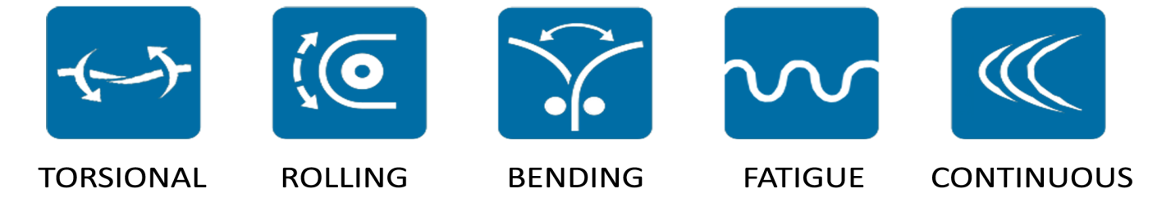
Aluminium Flexible Cables
Motion Types
Our target is
“Strain-Relief Conductor and Tension-Proof Insulation”
- The Higher Tensile Strength,
- The Finer Wires,
The Higher Flex Life,

Slide 32
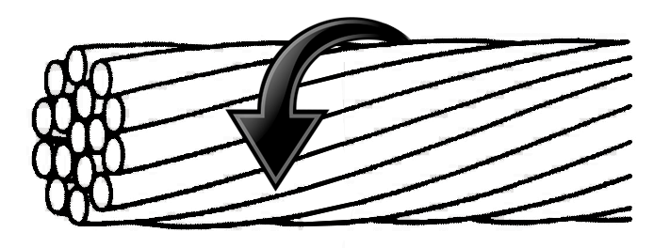
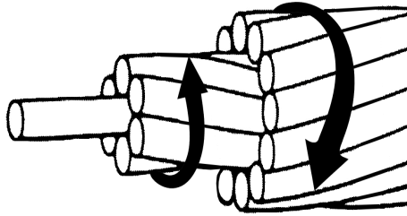
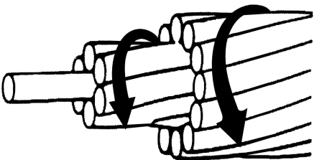
Aluminium Flexible Cables
Motion Types
Flexible Conductor Stranding Types
BUNCH: Same Lay ratio and direction, mostly used in fixed installations. Toron/Stranding bunching of Rope Lay or Cross-Sections up to 10mm²
CONCENTRIC CONTRA-HELICAL: Each layer has a reversed lay direction and an increasing or same lay length in each succeeding layer. Applicable for torsional and flexible motions.
ROPE LAY or CONCENTRIC UNILAY: Individual bundles of toron/stranding twisted together into groups with the same lay direction and length (or inreasing lay length) with a well defined geometric configuration. Applicable for torsional and flexible motions.

Slide 33
Aluminium Flexible Cables
Motion Types
Flexible Conductor Stranding Parameters
1- Tensile Strength of Wires
2- Wire Diameters
3- Number of strands
4- Lay directions of strands and layers
5- Lay Lengths of strands and layers
6- Annealing or Heat Treatment

Slide 34
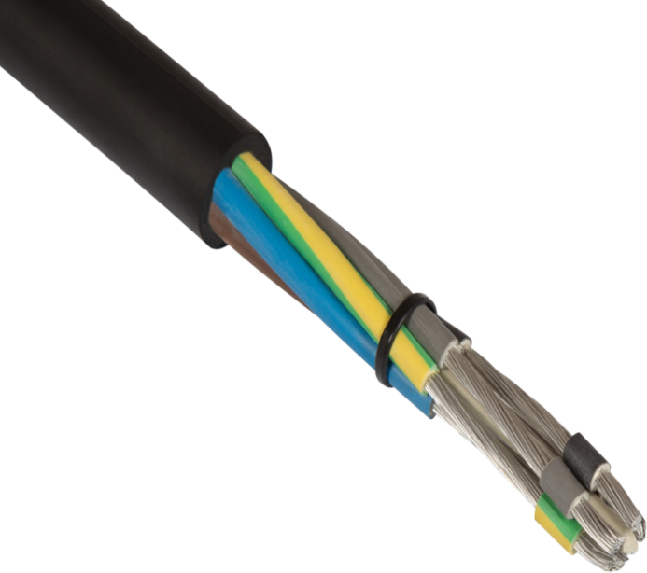
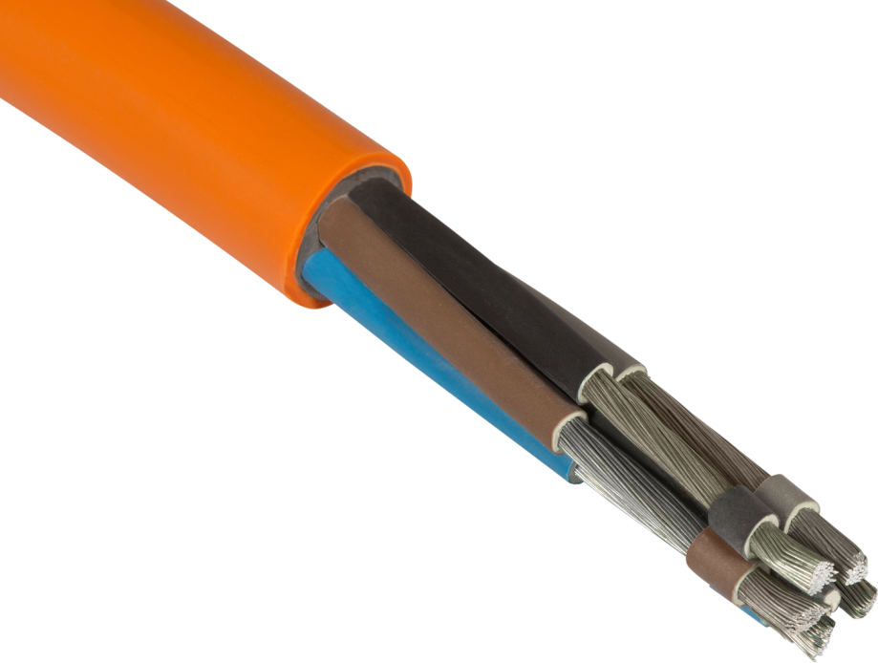
Aluminium Flexible Cables
Extension Leads_Multi Core Cables
Cable Construction- PVC
- Flexible Aluminium Conductor
- Annealing of Wires (Optional)
- Colourful Separator Film/Tape
PVC Insulation
PVC Sheath
Cable Construction- CSP
- Flexible Aluminium Conductor
- Annealing of Wires (Optional)
- Colourful Separator Film/Tape
CSP Insulation
CSP Sheath

Slide 35
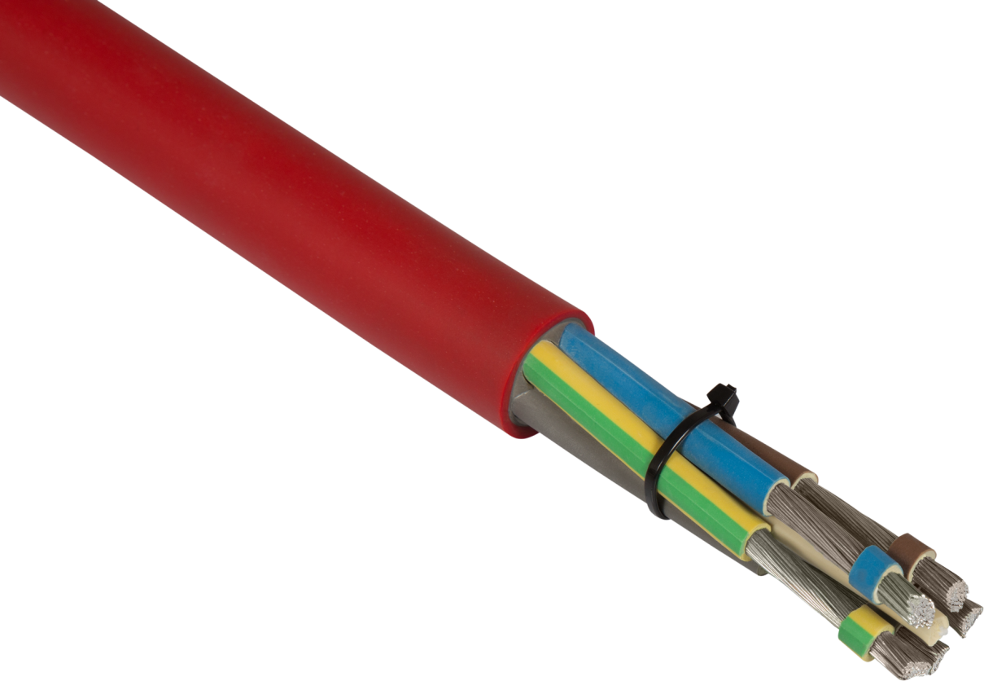
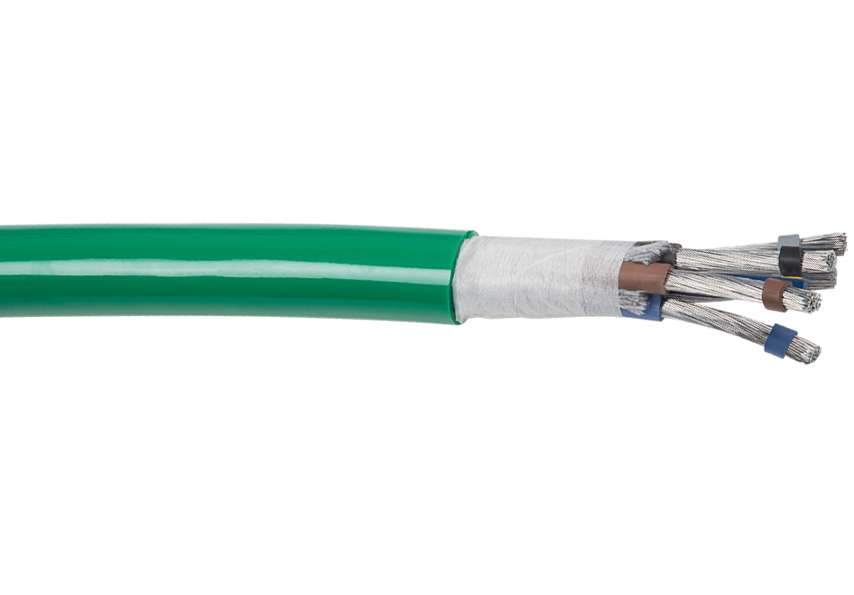
Aluminium Flexible Cables
Extension Leads_Multi Core Cables
H07BQ-AF / S07BQ-AF
- Flexible Aluminium Conductor
- Annealing of Wires (Optional)
- XLPE Insulation
Filler Cotton Yarn
PUR Sheath
H07BN4-AF / 07BN4-AF
- Flexible Aluminium Conductor
- Annealing of Wires (Optional)
Colourful Separator Film/Tape
EI 7 EPR Insulation
EM 7 or CSP Sheath

Slide 36
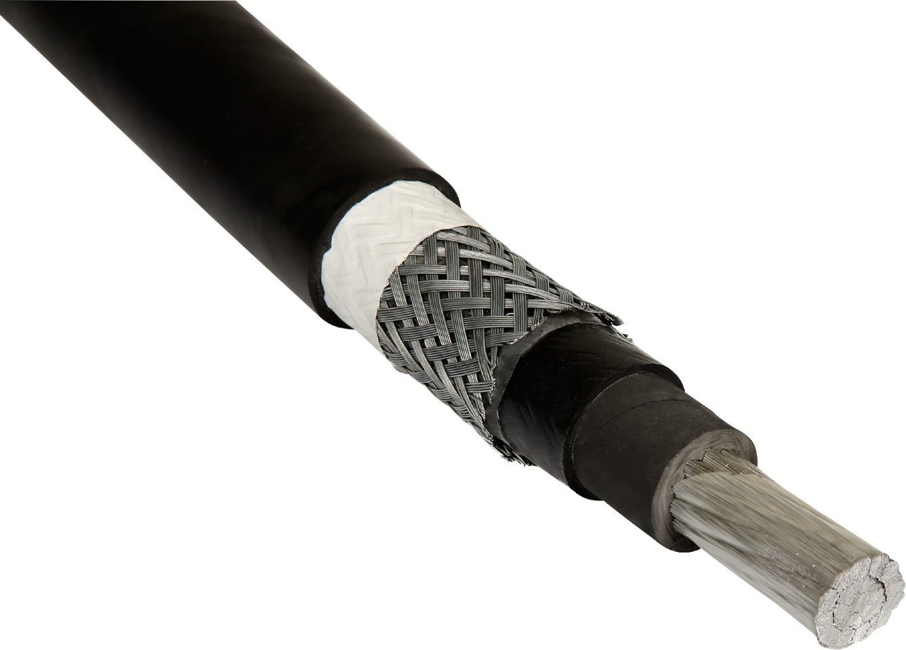
Aluminium Flexible Cables
Wind Turbine Cables
Cable Construction
- Flexible Aluminium Conductor
- Annealing of Wires (Optional)
- Transparent Separator Film/Tape
EPDM Insulation
Galvanized Steel Wire Shielding
CSP Sheath

Slide 37
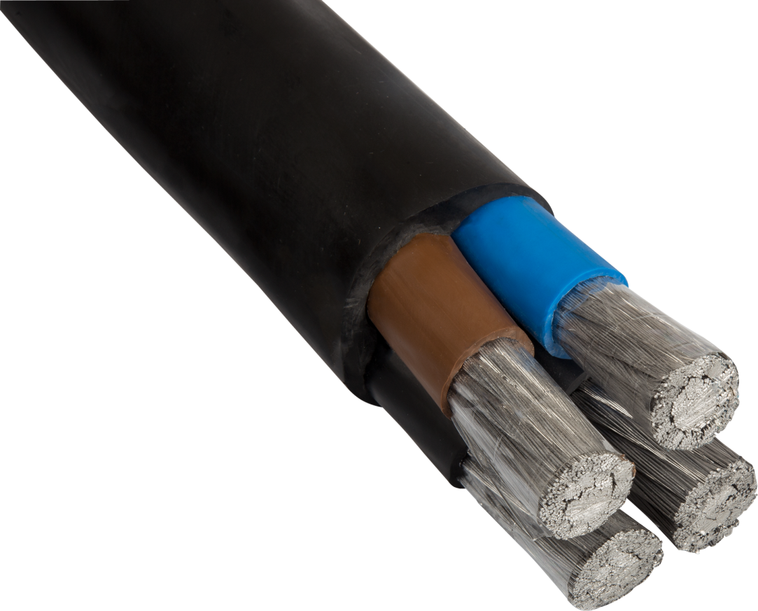
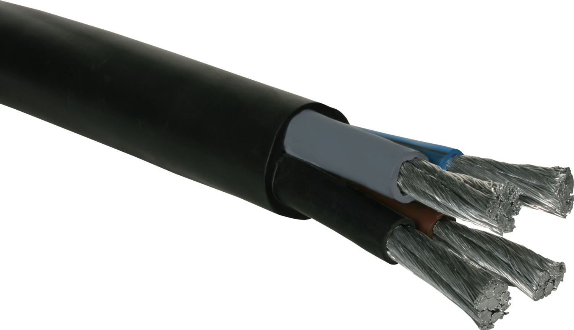
Aluminium Flexible Cables
Multi Core Cables
Cable Construction
Flexible Aluminium Conductor
Transparent Separator Tape
Thermoplastic Elastomeric Insulation
Thermoplastic Elastomeric Sheath

Slide 38


Aluminium Flexible Cables
Railway Cables
H07BQ-AF / S07BQ-AF
- Flexible Aluminium Conductor
- Annealing of Wires (Optional)
Colourful Separator Film/Tape
EI 6 EPR Insulation
TPE-U PUR Sheath
Railway – CSP Sheathed
Flexible Aluminium Conductor
Transparent Separator Tape
CSP Sheath

Slide 39


Aluminium Flexible Cables
One Core Flexible Cables
Welding Cables
- Flexible Aluminium Conductor
- Annealing of Wires (Optional)
Colourful Separator Film/Tape
EM 5 Sheath
Railway – PVC Sheathed
Fine Aluminium Wires
Compressed Rope Lay Stranding
PVC Sheath

Slide 40






Aluminium Flexible Cables
Aircraft and Automotive Power&Battery Cables
Characteristics
Applicable in Vehicles, Aircrafts since 2000s
Ref. Standard: LV 112-2 and ISO 6722-2
Fine Annealed Aluminium Wires
PVC, XLPO, HFFR or other insulation materials
Applied to battery, door, roof compartments
Cross-Section Range 0,75≈160 mm²
Weight: Approx. 60% of Harness consists of Cables.
Carbon Emission: Approx. every 100 kg reduction saves 0,6 lt in 100 km.

Slide 41

Aluminium Flexible Cables
Tests of Aluminium Flexible Conductor&Cable
Flex Life Tests acc. to ASTM B 470, UL 1277 or OEM Specifications
Rolling Tests,
Bending Tests,
Torsional Tests,
Aluminium Series
DIN EN 573-3
Individual Wire Tests
ISO 6722-1, ISO 6722-2
ASTM B 470, ASTM B230, ASTM B233, ASTM B609, BS 2627
Insulation&Fire Tests
OEM Specifications, ISO 6722-1 or Equivalent Copper Standards

Slide 42
Content of Presentation
1- Analyzing the feasibility of Aluminium Cables
1.1- Reel Disadvantages of Aluminium Cables
1.2- Comparisons of Conductive Metals in various applications
2- Underground&Aerial&Building Applications
3- Aluminium Flexible Cables
3.1- Design Criteria&Tests of Aluminium Flexible Cables
3.2- Types&Application Areas of Aluminium Flexible Cables
3.3- Predictions on Aluminium Flexible Cables
4- Challenges of Aluminium Cables
4.1- Integrity of Fine Wires
4.2- Connection and Termination

Slide 43

Integritiy of Fine Wires
?
1. Correct Stranding Design to defined Motion Type
2. Correct Alloy Composition to Correct Cross-Section
1. Reduced Friction in Stranding/Bunching Process
2. Sensitive Wire Break Sensors
3. Annealing or Heat Treatment of Fine Wires to minimize backtwists
4. Colourful Separator Tape on Conductor
Design
Production

Slide 44
Connection, Termination, Crimping
Confusions about Aluminium Connection
Oxidation
Corrosion (Electromechanical_Galvanic)
- Creep (Cold Flow) & Thermal Expansion
Fatigue Performance in Mechanical Vibrations&Electrical Load Cycles
- Workmanship

Slide 45

Connection, Termination, Crimping
Workmanship
Operator is the most important "system component“
He must be competent and craftsman.
The process is not just "insert wire, compress lug".
Poor Workmanship&Imprudent Termination is generally recognized as the primary source of failed connections.
You can take precautions against oxidation but not workmanship.
An faulty operation might even cause a fire.
“Follow the guidelines!!!”

Slide 46
Connection, Termination, Crimping
Oxidation
Very fast a thin layer of Aluminum Oxide (Al₂O₃ forms) on the surface. Al₂O₃ is one of the hardest and brittle materials known and acts as an electrical insulator.
This layer can reach 4nm thickness (increasing with time)
Resistivity 10^12 Ω m
Dielectric Strength 35 MV/m
Theoretical Surface Resistance ≈ 4 kΩm²
Breakdown Voltage for contacts ≈ 0,14 V
?_Power Application (>100 Volt):
??_Automobile Application (=10 Volt):
- ???_Communication&Signal (<1 Volt):
Source: Prof. Dr.-Ing. Hans-Dieter Ließ
Bundeswehr University Munich

Slide 47


Connection, Termination, Crimping
Corrosion
inherent tendency to revert from a processed, metallic state to their natural state, “Ore”.
Aluminium
Bauxite Ore
Aluminium Hydroxide
(Al(OH)₃)
Alumina
Aluminium Oxide
(Al₂O₃)
Aluminium
Corrosion (Galvanic_Electrochemical)
Contact with Salt Water or Moisture
Bauxite Ore
Oxidation
Contact with Oxygen or Air
Alumina
Photo: Klauke

Slide 48


Connection, Termination, Crimping
Creep&Cold Flow&Thermal Expansion
Assumption | Cross-Section
 | Cu | Al
Equal Conductivity | 1,00 | 1,60
Equal Thermal Expansion | 1,00 | 1,40
To prevent Creep&Cold Flow in the Conductor
Correct Alloy Composition - Motion Type Matchup (i.e 6mm²)
Correct Compression Lug
Compression Force; partial cold weld is preferred.
Qualified Workmanship
Correct Conductor Stranding - Motion Type Matchup
Consider Installation Factors

Slide 49


Connection, Termination, Crimping
Fatigue Performance
In fixed installation of Solid and Stranded Conductors;
Correct Conductor - Connector Matchup (RE ,SE ,RM, SM)
Correct Cross Section - Lug Selection
Qualified Workmanship
Heat shrinkable Sleeve on both insulation and connector lug
Consider Environmental Conditions (-40⁰C…+40⁰C, Heavy Duty)
In fixed installation of Flexible Cable;
If you make a good connection, no problem for small Mechanical Vibrations and Electrical Load Cycles, i.e Automobiles.
In flexible installation of Flexible Cable;
Neither market nor industry has enough knowledge, demand and experiences about the fatigue behaviors.
Source: www.mencom.com

Slide 50




Connection, Termination, Crimping
How should be a qualified Compression Lug?
Compound additive with grinding effect breaks oxide layer and also prevents further oxygen penetrating the contact joints.
Barrier Design (must be sealed with a plastic plug provides a good water and oil blockage)
Maximum Contact Surface (Hexagonal Crimping or F Crimping)
Longer Lug contributes connection quality
Tin plating stops the lug from oxidizing, also useful for galvanic activity.
A burr free lug and a cleanly machined end are signs of a high quality product with show a clean and vertical tune end.
Correct Conductor Compression Lug Matchup
Brand name with conductor and crimping dimensions engraved on connector
Compatible with standards and conductor types (RE_SE_RM_SM)
Photos: Klauke

Slide 51







Connection, Termination, Crimping
Hexagonal or Half Moon or Dual Rated Screw
F Crimping (Indent)
Applicable for RE-RM-SE-SM Conductors
Most satisfied and reliable crimping method in order to obtain maximum contact surface
RE&SE cross section sizes are different from RM&SM for the same cross-section
Correct crimping die and force enable correct crimping depth. Also prevent joint resistance.
For Aluminium Class 5 and 6
Less Compression than Copper
Sharp-Edged Serrations
Sonic Welding rather than Friction welding or soldering ??
Wire Crimp
Insulation Crimp
Photos: Klauke
Photos: TE Connectivity
Serrations

Slide 52












Connection, Termination, Crimping
Crimping Types and Test Standards
Any other crimping are applicable as long as compatible with standards and do not cause problem at connection points.
Conductor | Lug Dimensions | Equipment & Application | Test & Quality Control
EN 60228 EN 50185 ISO 6722-2 DIN 48201 | DIN 46235 DIN 48083-4 EN 13600 DIN 46329 DIN 46267-2 | DIN 48083-1 DIN 48083-3 UL 486 A/B | IEC 61238 EN 61238 UL 486 A/B

Slide 53


Connection, Termination, Crimping
How to make a reliable connection
First, the insulation is stripped. Second, the exposed part of the conductor is wire brushed. Third, an oxide inhibitor is applied. Finally, the connector is tightened to the recommended value.
Brush only in one direction and not too forceful. Forceful brushing
can embed oxides in the wire.
Sufficient paste should be applied and distributed evenly over the entire conductor surface. Ensure surface of conductor is completely covered with the contact paste.
Start the first crimp at the lug end and progress towards the conductor to ensure that compacted material expands in this direction.
After crimping, a heat shrink sleeve should be applied. The
purpose of this sleeve is to prevent the ingress of moisture or dirt at the junction.
“Without a Qualified Workmanship, it is a Fairy Story!!!”

Slide 54

Connection, Termination, Crimping
Small components with a great impact, even Fire!!!
Interoperability of Accessories, Aluminium and Copper
Workmanship Quality, Keep off Imprudent Termination
Compound/Grease/Oxide inhibitor,
Creep, Thermal Expansion, Voltage Drop Factors
Material Grade of Aluminium Alloy Conductor
Environmental Conditions
Connector/Terminal Tools Quality
Different manufacturer or installers have different method.
Proper tightening torque
Periodic inspection

Slide 55
Thank you…
SELMAN ÜNLÜ
Mech. Eng, Deputy G.M.
Mail: selmanunlu@sahrakablo.com
Mobile: 00 90 532 216 64 78
Download this presentation at www.sahrakablo.com

